Slide 1
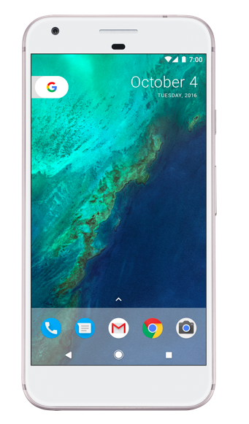

COFFEE TIME
2017 Hack the North
By Coffee team

Slide 2
About
Coffee Time provides an easy platform that allows others to pick up your coffee for you

Slide 3
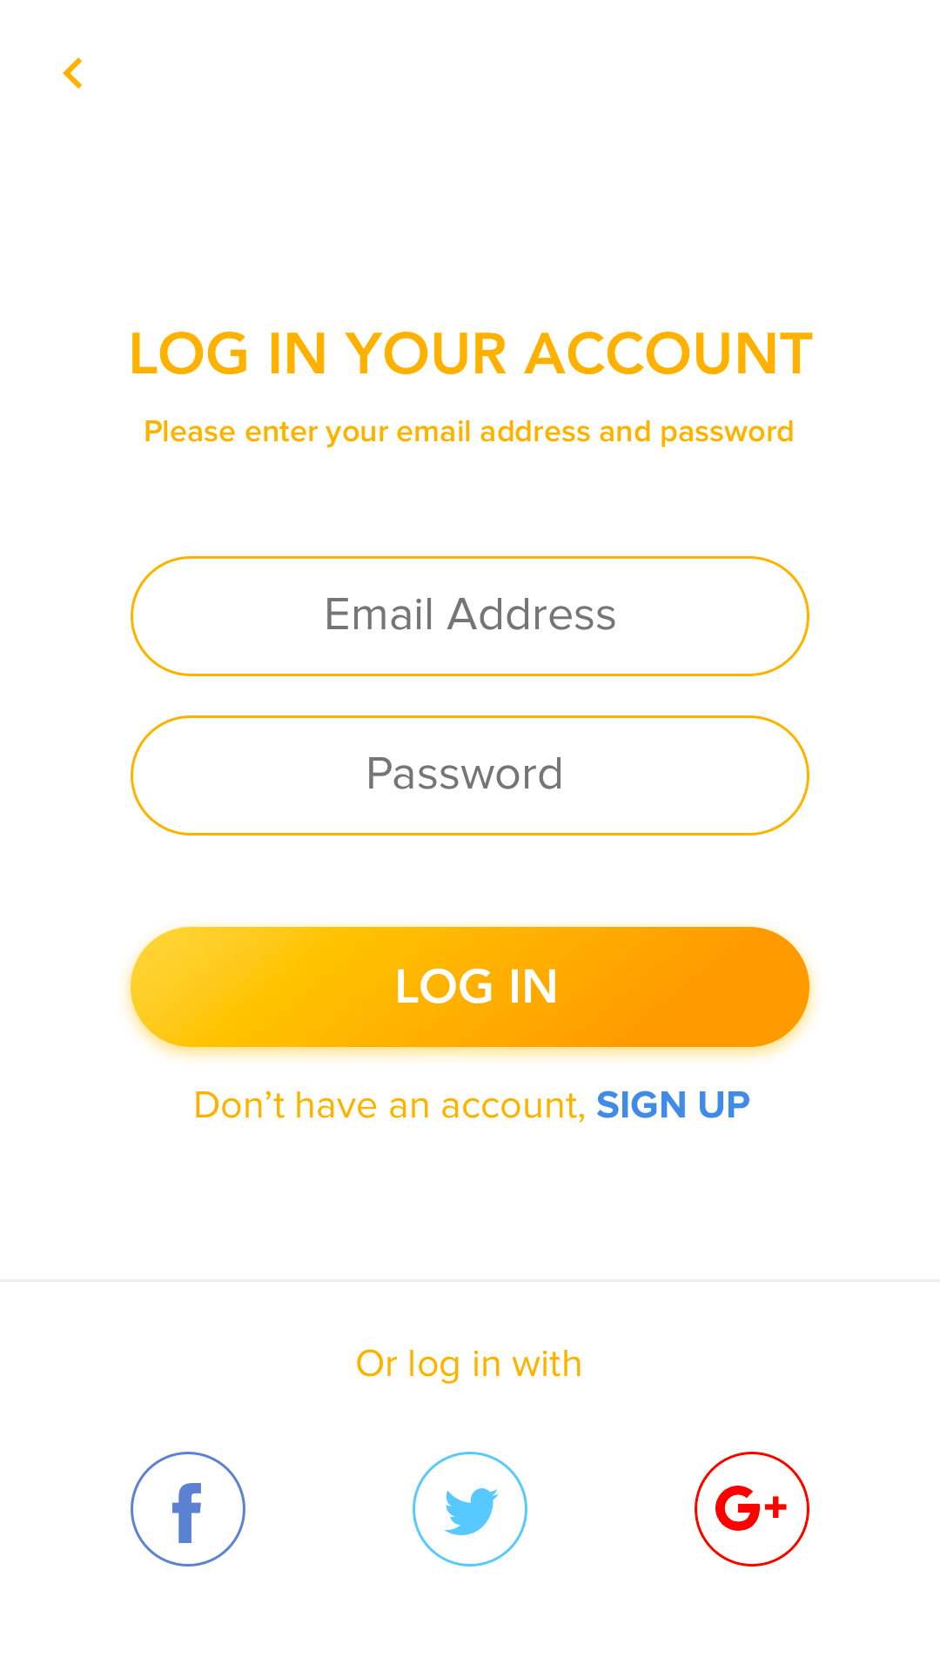
1.
CREATE ACCOUNT

Slide 4
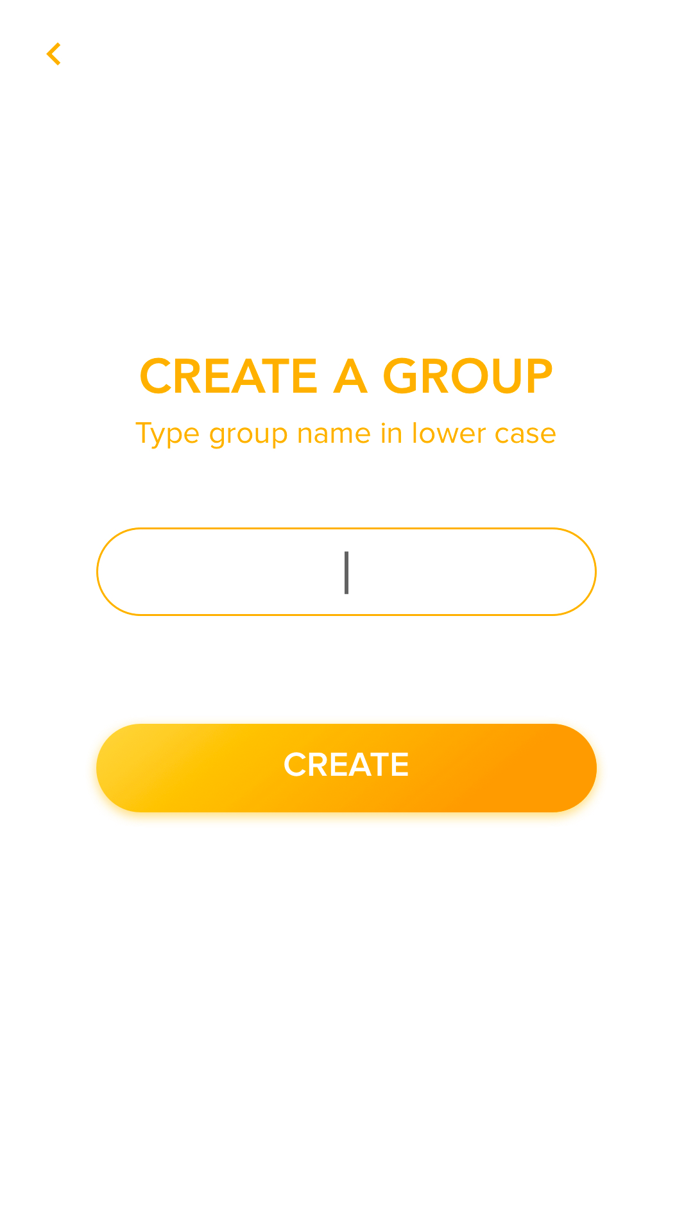
2.
CREATE A GROUP

Slide 5

3.
JOIN A GROUP

Slide 6
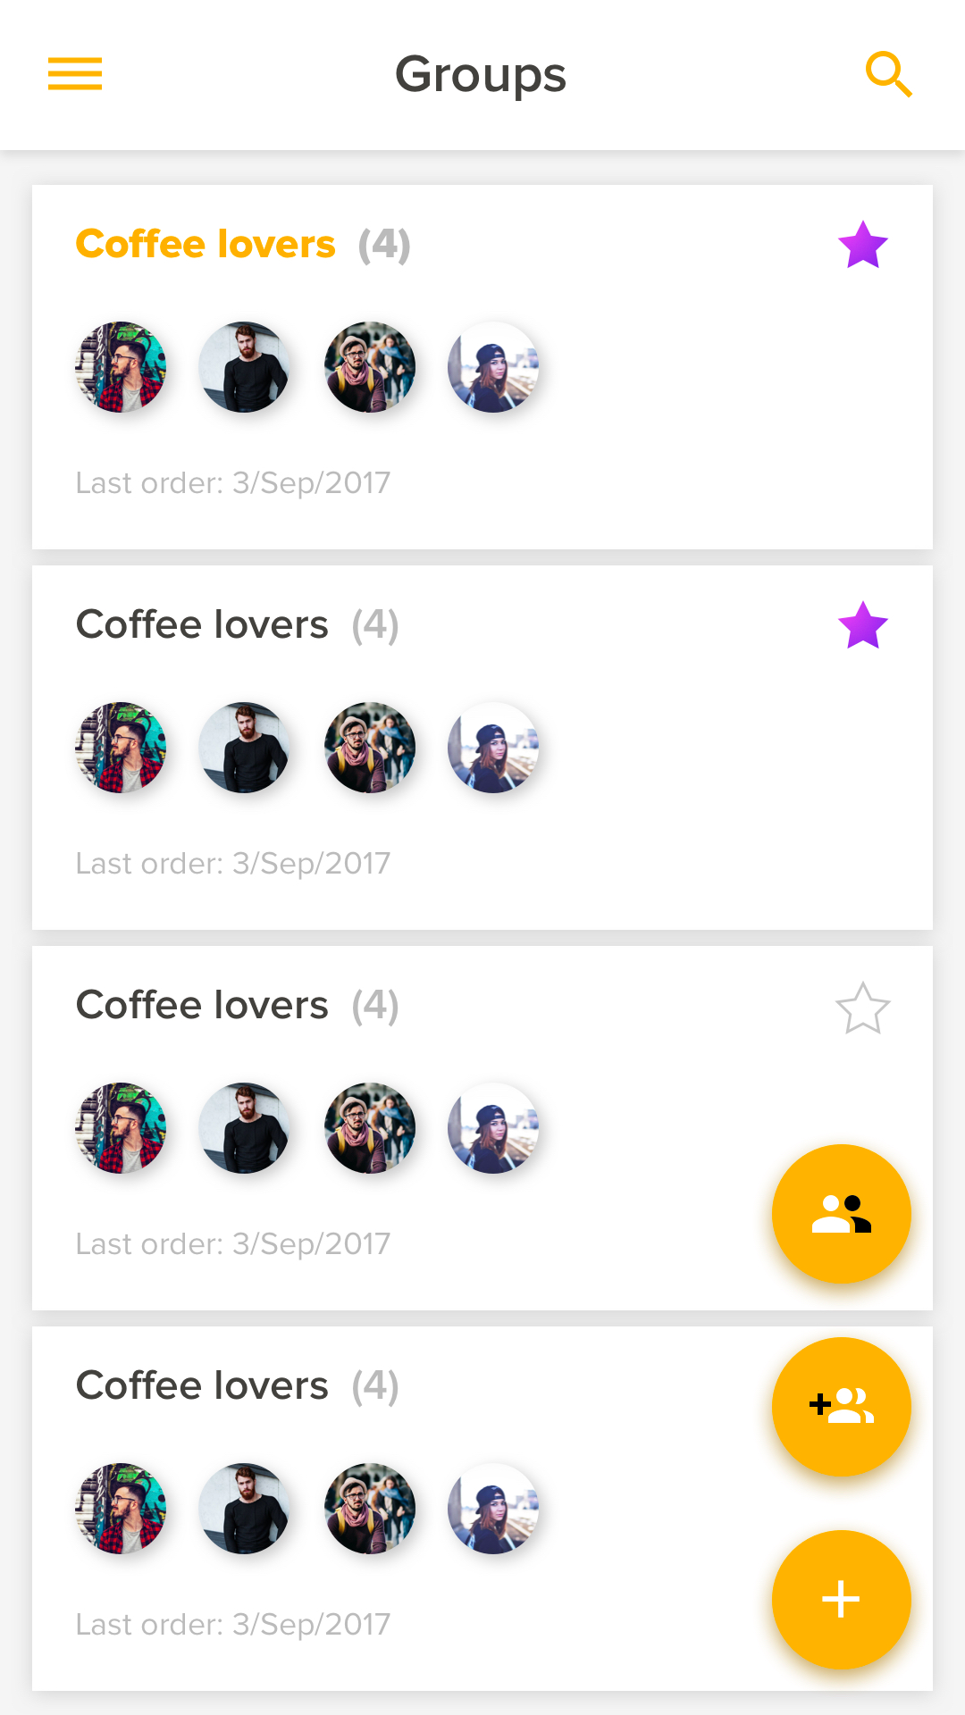
4.
VIEW GROUPS

Slide 7
5.
START A NEW ORDER

Slide 8
6.
OTHERS JOIN

Slide 9
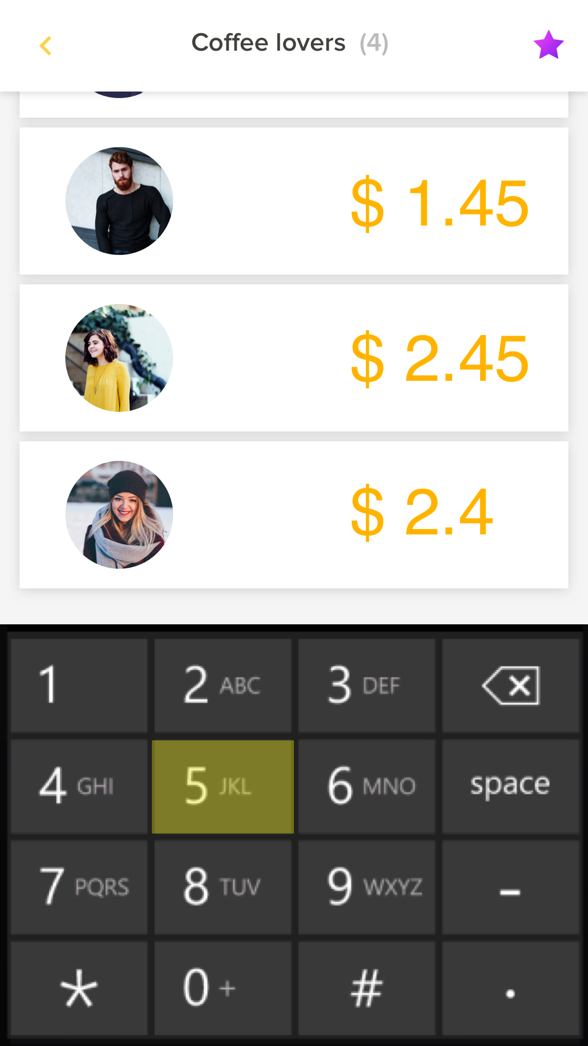
7.
ENTER THE BILL AMOUNT

Slide 10
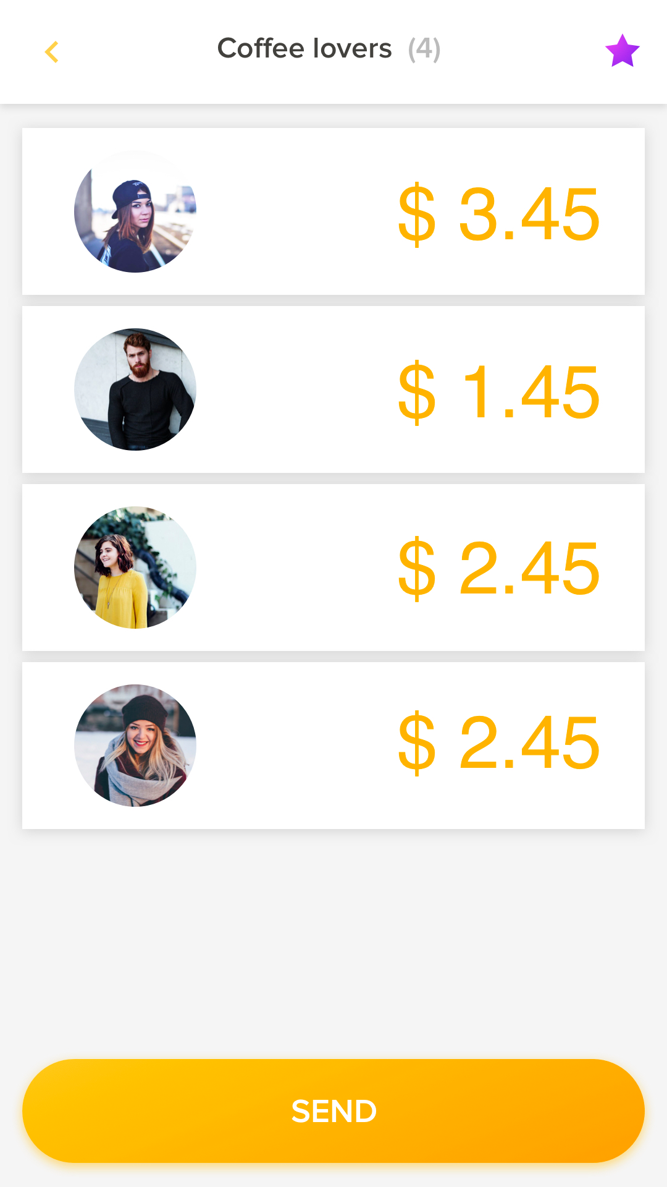
8.
SEND OUT
THE BILL

Slide 11
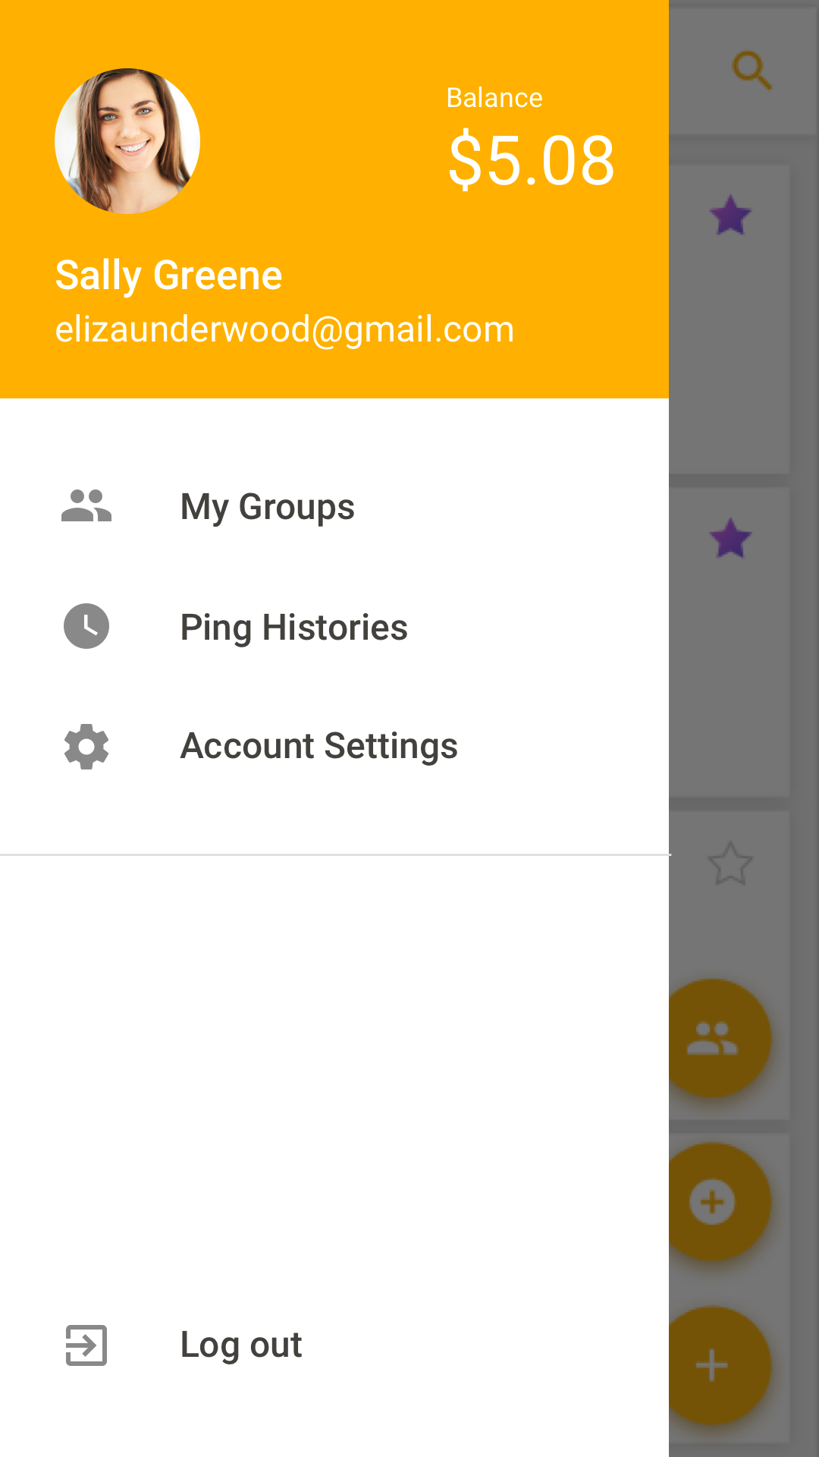
9.
ADDITIONAL
SETTINGS

Slide 12
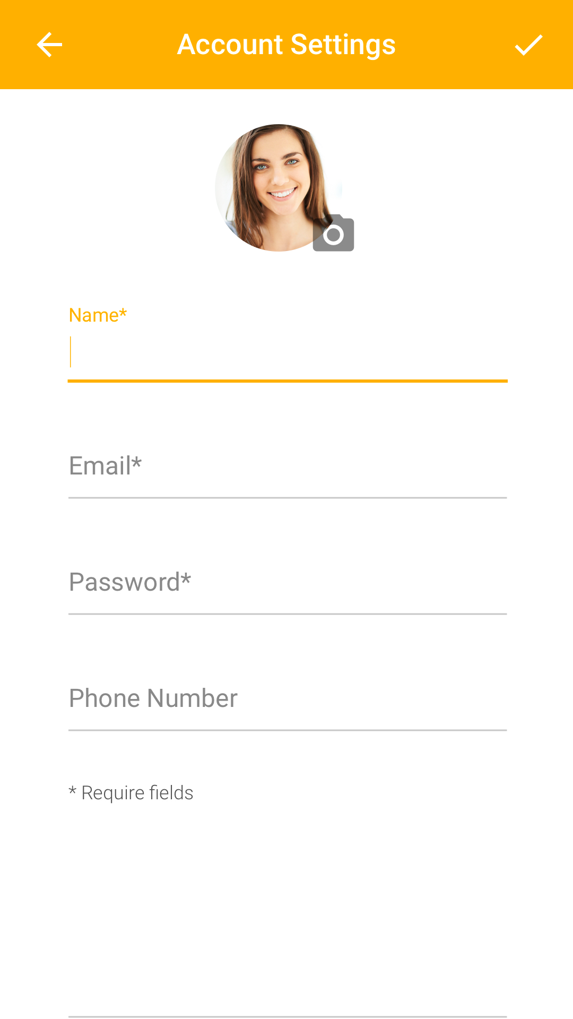
10.
SETTING ACCOUNT

Slide 13
Next Steps
“Great things never came out of comfort zones”.

Slide 14
Our Motivation.
“Great things never came out of comfort zones”.

Slide 15

ENJOY THE HAPPY SHARING MOMENT

